Slide 2
Session 2
30/8/2022
Task 1:
What are the components of OS?
Process management
File management
Network management
Main memory management
Secondary storage management
I/O Device management
Security management
Command interpreter system
How Kernel works and manage processes?
Manage RAM memory, so that all programs and running processes can work. Manage the processor time, which is used by running processes.
Task 2:
How To Hide Password in Python?
Pip install maskpass
Import maskpass
Pwd=maskpass.advpass()

Slide 3
Task 3:
How to write C++ in jupyter?
By using mybinder.org
Task 4:
How to make do while in Python?
while True:
if condition:
break
for Example:
while True:
number = int(input(“enter a positive number: “))
print (number)
if not number > 0:
break
Task 5:
How to write for loop and iterate times 2?
for x in (2**p for p in range(1, 11)):
print(x)

Slide 4
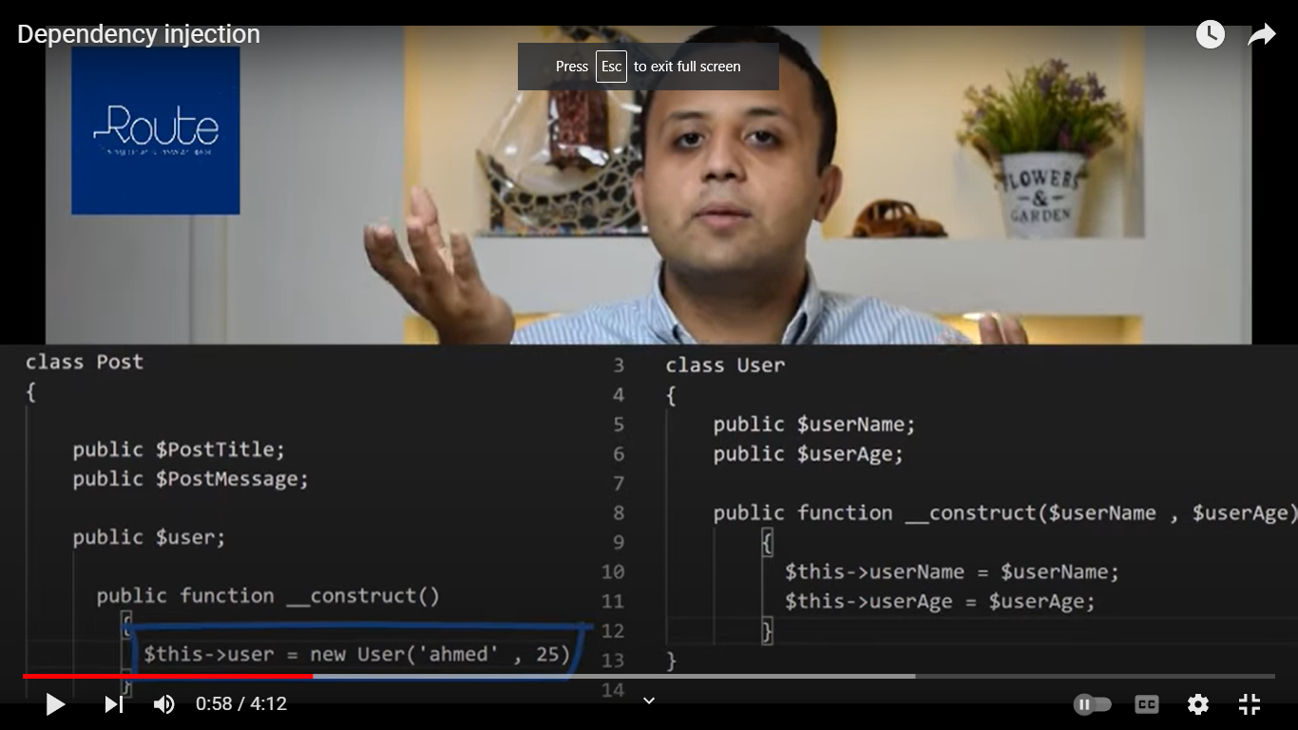
Task 6:
How to make infinite for loop in python?
Can do this by itertools package and import cycle
from itertools import cycle
a= [100]
for I in cycle(a):
print(I)
Task 7:
What is the dependency injection?[1]
Dependency : when a class depends on another class

Slide 5
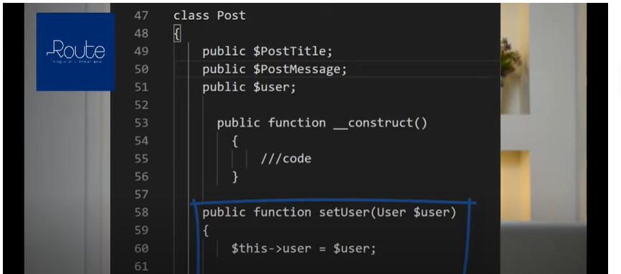
Class post depends on class user
دلوقتى لما كلاس يكون معتمد على كلاس تانى لو غيرت حاجه فى الاساسى لازم اغير فى كل اللى معتمدين عليه ف احنا لو بنتعامل مع سيستم كبير دى كدا هتكون مشكله ف من هنا ظهر المفهوم دا يعنى بحاول اظبط انى لو عملت اى تغير يبقى ميأثرش على الباقى:
In object-oriented programming software design, dependency injection is the process of supplying a resource that a given piece of code requires. The required resource, which is often a component of the application itself, is called a dependency.[2]
Advantages:
basic benefit of dependency injection is decreased coupling between classes and their dependencies.

Slide 6
Task 8:
What are the Rules of clean code?
-Clean code rules by Robert C. Martin:
Names Rules:
Choose descriptive names.
Makes meaningful.
Example: Bad: var d; // elapsed time in days
Good: var elapsedTimeInDays.
var daysSinceCreation.
var daysSinceModification.
Use pronounceable names.
Use searchable names.
Example:Bad: if (student.classes.length < 7) { // Do something}
Good: if (student.classes.length < MAX_CLASSES_PER_STUDENT) { // Do something}
Functions Rule:
Small
Do one thing
Use descriptive names
Prefer fewer arguments
Comments Rules
Always try to explain yourself in code
Don’t be redundant
Don’t comment out code
Don’t add obvious noise

Slide 7
Task 9:
Why recursion faster than iterative?
All programs work on main thread, but if want to give a specific task a priority to done we must put it in new thread
In recursion we will add each calling of recursion in separate thread, but in iteration can’t work
Task 10:
What are the threads?[3]
A Thread is the basic unit of CPU utilization
A process starts with a single thread and later can create more threads from any of its threads
All threads of the same process have access to its memory
A thread is a path of execution within a process. A process can contain multiple threads.
The primary difference is that threads within the same process run in a shared memory space, while processes run in separate memory spaces. Threads are not independent of one another like processes are, and as a result threads share with other threads their code section
A thread is the smallest unit of processing that can be performed in an OS.
Threads are a popular way to improve the performance of an application through parallelism.

Slide 8
Its consists of:
Program counter
Stack
Set of registers
A unique id
Advantages:
Responsiveness: If the process is divided into multiple threads, if one thread completes its execution, then its output can be immediately returned.
Faster context switch: Context switch time between threads is lower compared to process context switch
Resource sharing: Resources like code, data, and files can be shared among all threads within a process.
Communication: Communication between multiple threads is easier, as the threads shares common address space.
Enhanced throughput of the system: If a process is divided into multiple threads, and each thread function is considered as one job, then the number of jobs completed per unit of time is increased, thus increasing the throughput of the system.
Types of the Threads:
User level
Kernel level

Slide 9
References:
https://www.youtube.com/watch?v=YO4MGNu2xvI
https://www.techtarget.com/searchapparchitecture/definition/dependency-injection
https://www.techopedia.com/definition/27857/thread-operating-systems

